Slide 1

ROAD ACCIDENT DASHBOARD
Presented by team A

Slide 2
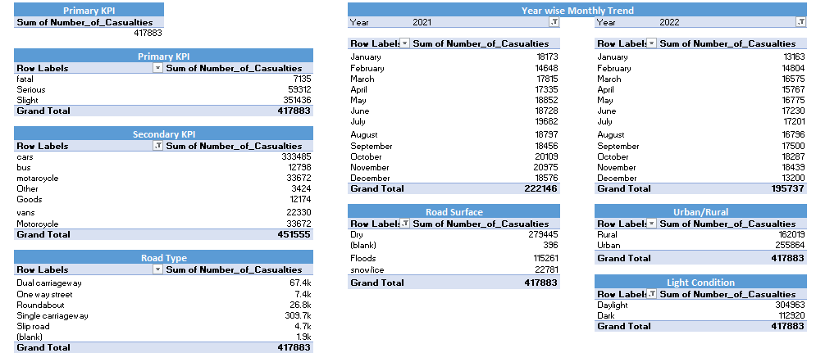
Data Analysis Sheet Creation

Slide 3
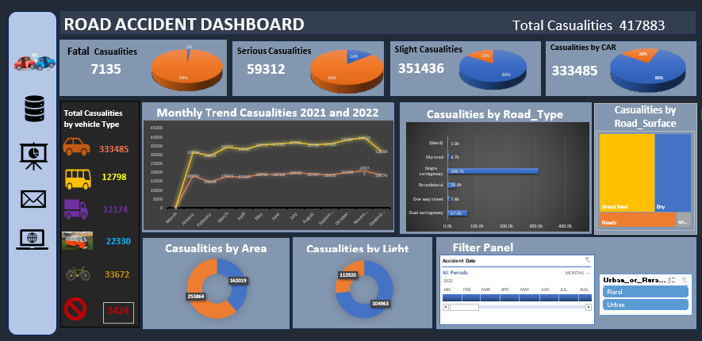
DASHBOARD

Slide 4
THANK YOU

